Slide 1


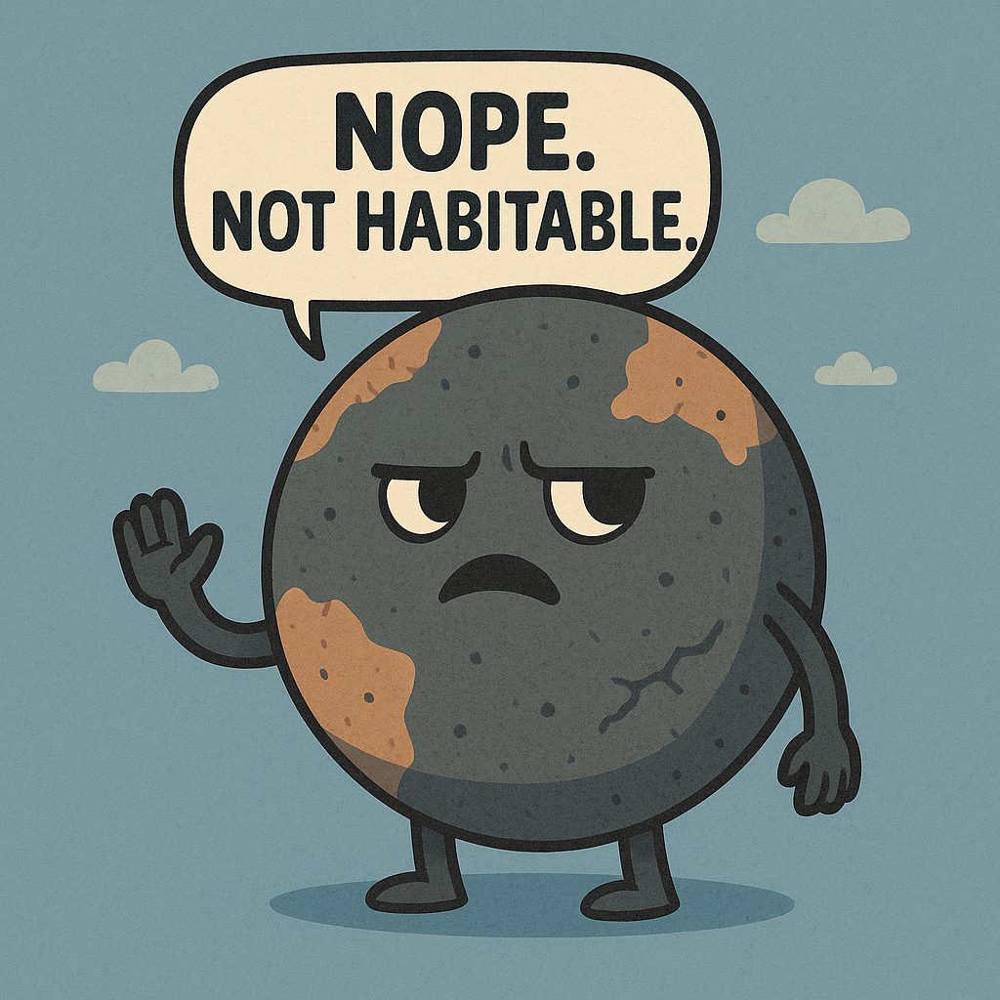

ML PROJECT ON EXOPLANET HABITABILITY PREDICTION
By-
Name- Pranjal Sinha
Reg. no.- 12206214
Roll no.- B53

Slide 2
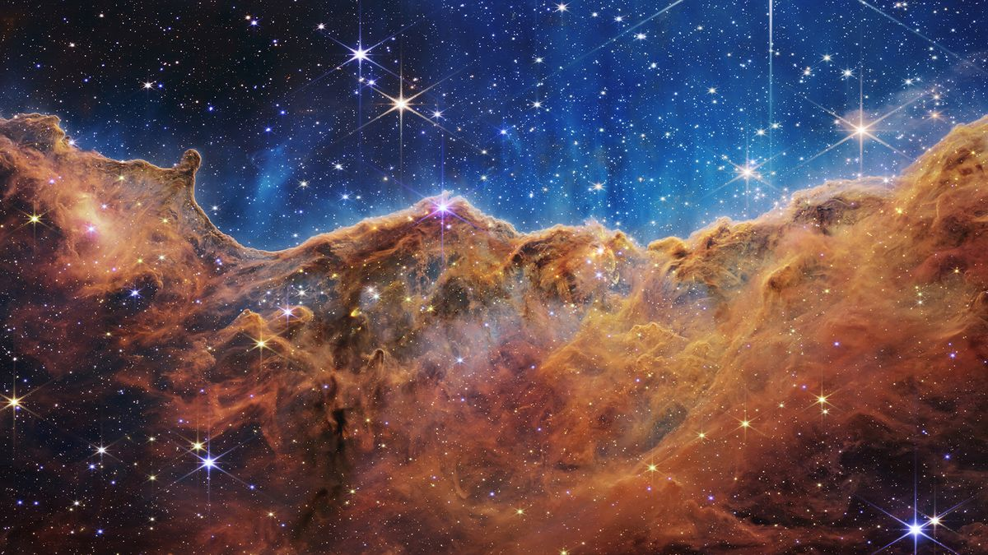
INTRODUCTION
Exploring Earth-like Worlds Beyond Our Solar System
Thousands of exoplanets have been discovered, but finding those like Earth remains a major goal.
Instead of traditional observation methods, this project uses unsupervised machine learning to group exoplanets by Earth-likeness — uncovering patterns without needing labeled data.

Slide 3
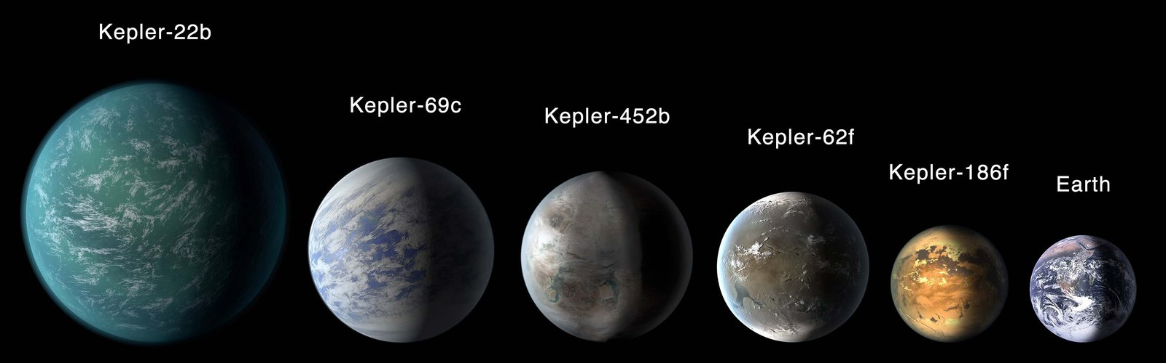
PROBLEM STATEMENT
From Habitability Classification to Earth-
Likeness Clustering
The original goal was to classify exoplanets based on their habitability. However, due to the lack of labeled data indicating which exoplanets are actually habitable, we shifted to an unsupervised learning approach.
Our Goals:
Group similar exoplanets using unsupervised learning
Measure Earth-likeness by comparing to Earth’s parameters
Build a webpage for users to input planet data and get insights

Slide 4

DATASET DESCRIPTION
Description:
5000+ confirmed exoplanets.
Over 90 features including planetary and stellar properties.
Key parameters include orbital period, radius, mass, equilibrium temperature, stellar temperature, and more.
Data Cleaning Involved:
Handling missing values.
Converting units to Earth-relative scales.
Filtering entries with critical missing data.

Slide 5
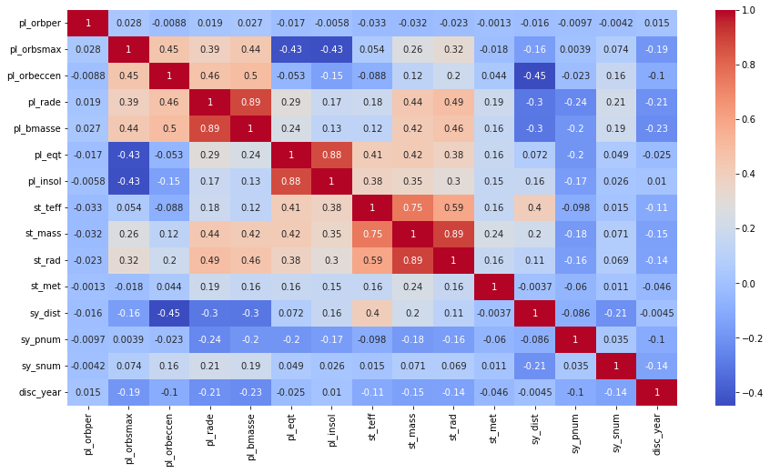
KEY FEATURES USED
A variety of features were used after careful EDA and domain research:-
pl_orbper: Orbital Period
pl_rade: Planet Radius (Earth units)
pl_bmasse: Planet Mass (Earth units)
pl_eqt: Equilibrium Temperature
st_teff: Stellar Effective Temperature
st_rad: Stellar Radius
st_mass: Stellar Mass
pl_insol: Insolation Flux
pl_orbeccen: Orbital Eccentricity
These features directly influence planetary conditions and potential for habitability.

Slide 6
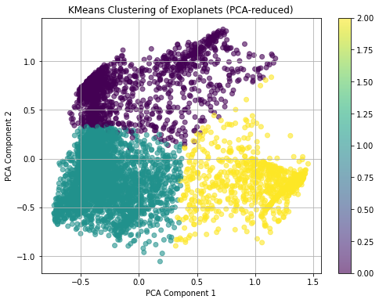
FEATURE ENGINEERING
Data Preparation at a Glance
Missing Values: Dropped critical nulls, filled the rest with median/mode
Scaling: Used StandardScaler to normalize all features
Dimensionality Reduction: Applied PCA (2D) while retaining ~90% variance
Earth Similarity Index: Evaluated, but skipped to maintain unsupervised integrity

Slide 7
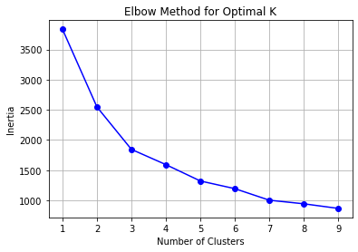
MODEL SELECTION
Clustering Approach
Tried KMeans — simple, fast, and effective
Chose K = 3 using the Elbow Method
Final Clusters:
Cluster 0: Earth-like
Cluster 1: Intermediate
Cluster 2: Unlikely to be habitable

Slide 8
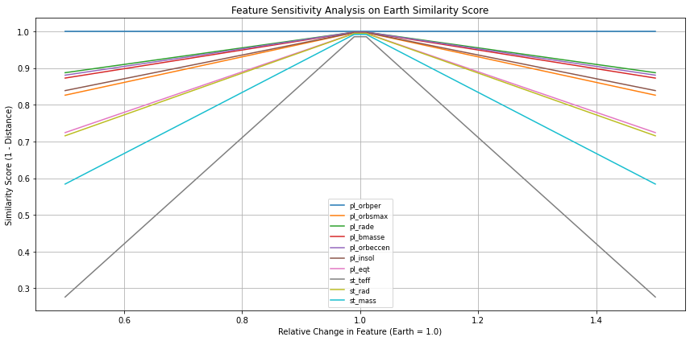
RESULTS
KMeans successfully divided the dataset into 3 clusters:
Cluster 0: Close to Earth's parameters (High Habitability)
Cluster 1: Moderately habitable planets
Cluster 2: Hot Jupiters, rogue planets, or extreme orbits (Low Habitability)
Visualized using PCA-reduced scatter plot. Distribution validated through cluster centers.

Slide 9
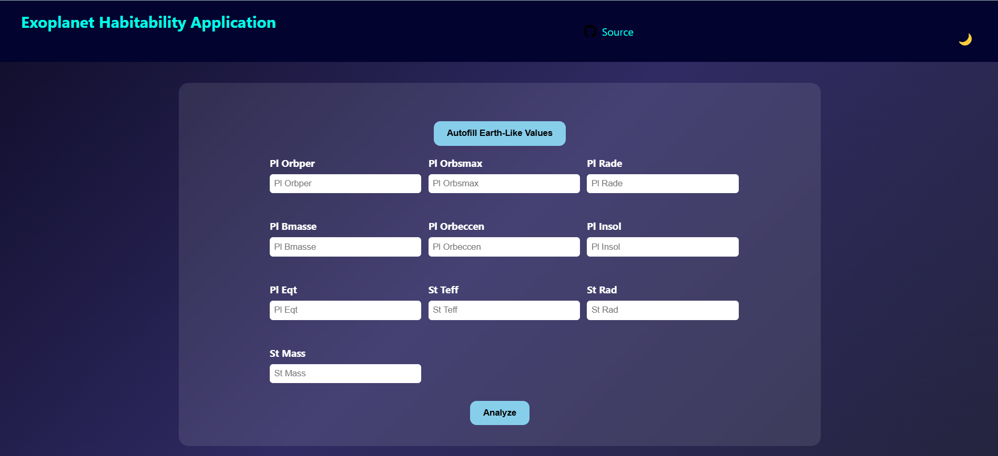
WEB APPLICATION INTEGRATION
Built with: Python (Flask), HTML/CSS, Bootstrap
What it does:
Users enter planet data
Model predicts habitability cluster
Key Features:
Input validation
Real-time results
Simple, user-friendly design

Slide 10

CHALLENGES FACED
Missing Data: Several critical columns had over 30% missing values.
Lack of Labels: Forced us to adopt unsupervised learning.
Feature Selection: Required astrophysical knowledge.
Cluster Interpretation: Naming clusters without labels was subjective.
App Integration: Linking backend ML model with a clean frontend took time.

Slide 11
CONCLUSION
In conclusion, this project successfully demonstrates the use of unsupervised machine learning to assess the habitability of exoplanets based on their similarity to Earth.
By leveraging astrophysical data and clustering techniques, we shifted from a traditional classification approach to a more exploratory analysis that enables insights into planetary characteristics without requiring predefined labels.
The development of a web application further enhances accessibility and practical application of the model. This work not only deepens our understanding of exoplanetary systems but also lays the foundation for future research in astrobiology and automated planetary analysis, with potential for real-world scientific exploration.

Slide 12
REFERENCES
NASA Exoplanet Archive: https://exoplanetarchive.ipac.caltech.edu/docs/data.html
Astrobiology papers from journals like AAS, Elsevier.
Scikit-learn Documentation
Flask Documentation
Open source astronomy datasets

Slide 13


Thank you for your time and attention! I appreciate the opportunity to share my project. A special thanks to my mentors, peers, and the faculty at Lovely Professional University for their support. I hope this presentation offered valuable insights into the role of machine learning in discovering habitable worlds beyond Earth.
GitHub Repository Link
Questions and feedback are welcomed!

